Slide 1
SIT113 Cloud Computing and Virtualisation
Week 10, Class 1
AWS

Slide 2
Outline
AWS https://aws.amazon.com/
Accounts
Free
Plans
Console
Sign In
Services
Resource Groups
Virtual Machines
Creation
Demonstration

Slide 3
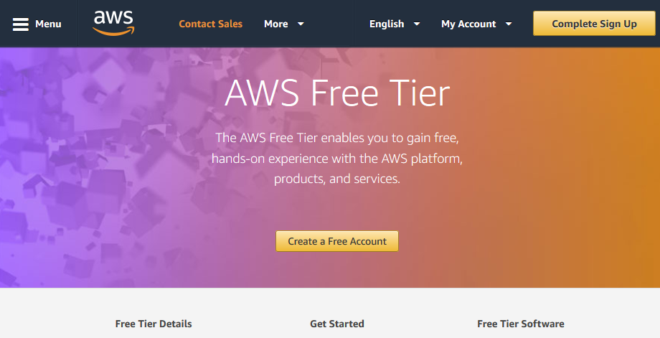
Accounts – Free Account
https://aws.amazon.com/free/

Slide 4
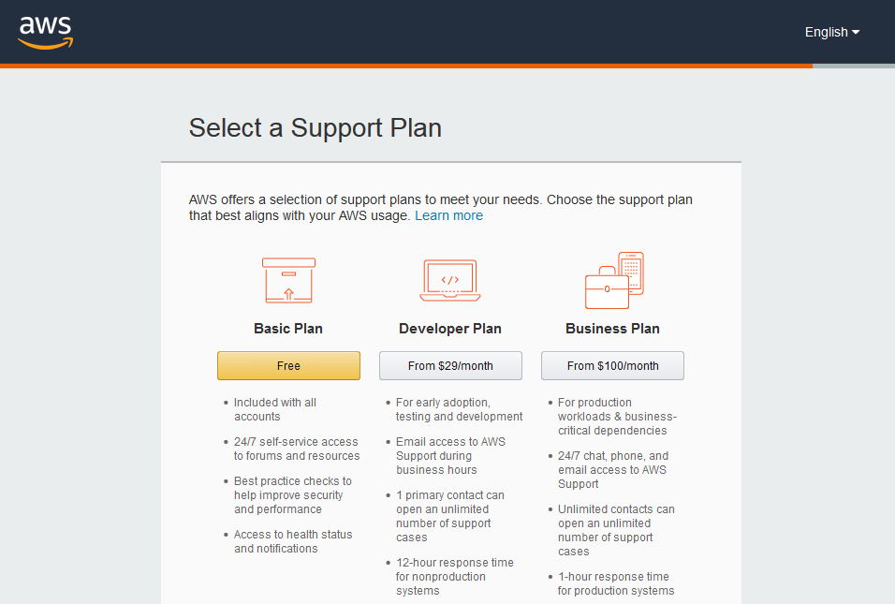
Accounts – Plans

Slide 5
AWS – Management Console
https://aws.amazon.com/console/
This is one place where you can login.
After login, many services are available such as:
compute: EC2, Elastic Beanstalk, …
storage: S3, EFS, …
database: RDS, DynamoDB, …
networking: VPC, Route 53, …
developer tools: Cloud9, CloudStar, …
and many more

Slide 6
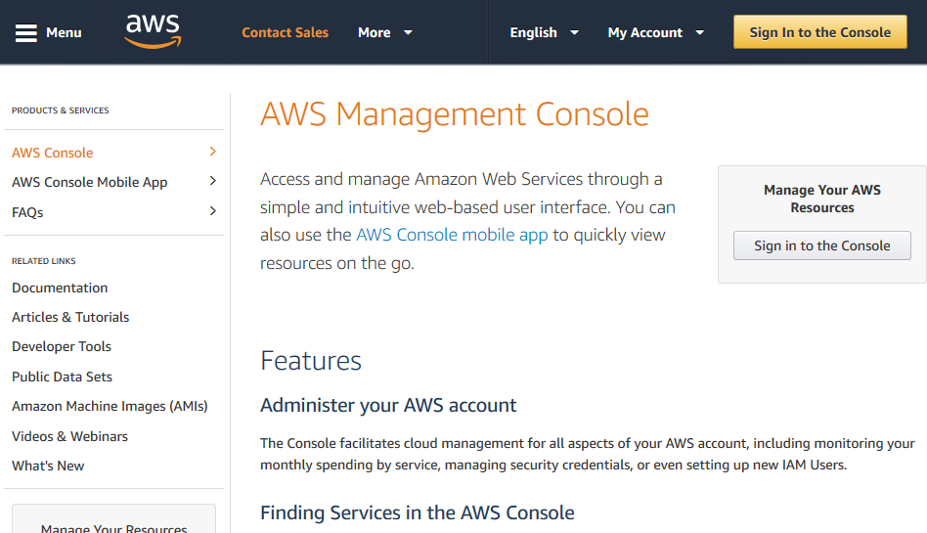
Accounts – Sign In
https://aws.amazon.com/console/

Slide 7
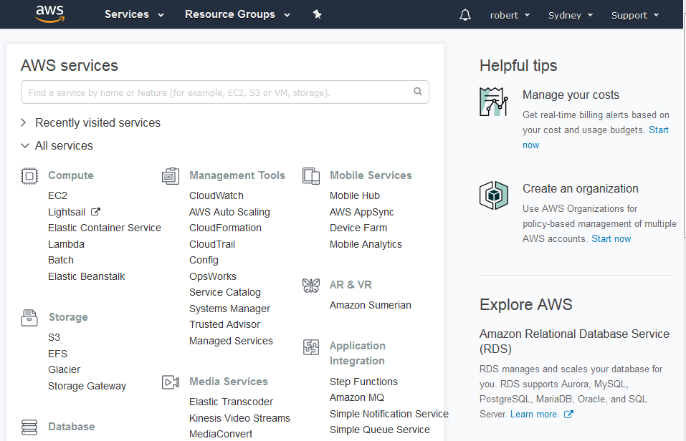
AWS – Services

Slide 8
Resource Groups
A resource group is used to:
group resources that are related in same manner based on one or more tags
You can:
find your tagged AWS resources
create logical groups of resources
manage logical groups of resources

Slide 9
Resource Groups
You might have many VMs, S3 buckets, and other AWS resources used for several projects.
If you tag all resources for a particular project with a unique tag, say Project XYZ, you can find all of those resources with that tag, and then manage those (maybe that project has terminated, and all resources need to be deleted)
For example, I have a resource group (SIT113 Resources) which I can use to group two VPCs with the tag of SIT113.

Slide 10
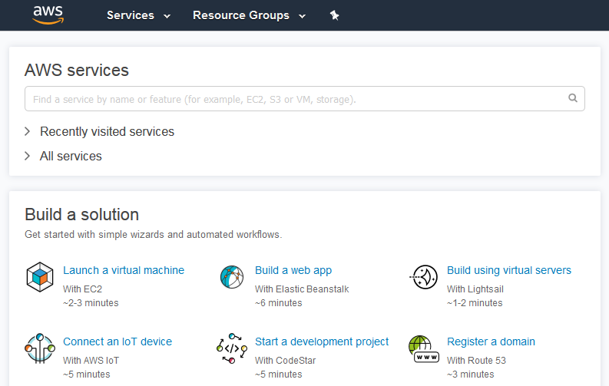
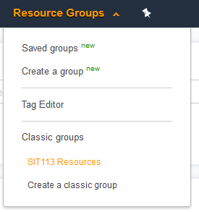
Resource Groups

Slide 11
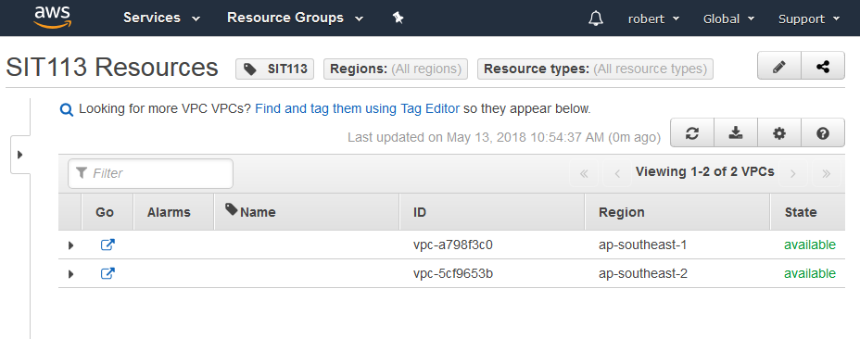
Resource Groups
The group SIT113 Resources contains two VPCs with the SIT113 tag.
These links provide access to the resources.

Slide 12
Virtual Machines
For a virtual machine (VM):
choose one when you need more control of the infrastructure
you don’t buy and maintain the physical hardware
you still need to manage software such as configuring, patching, installing
a snapshot of that VM can be created, i.e., a backup of the VM can be created, and later used to resume that VM from that snapshot time

Slide 13
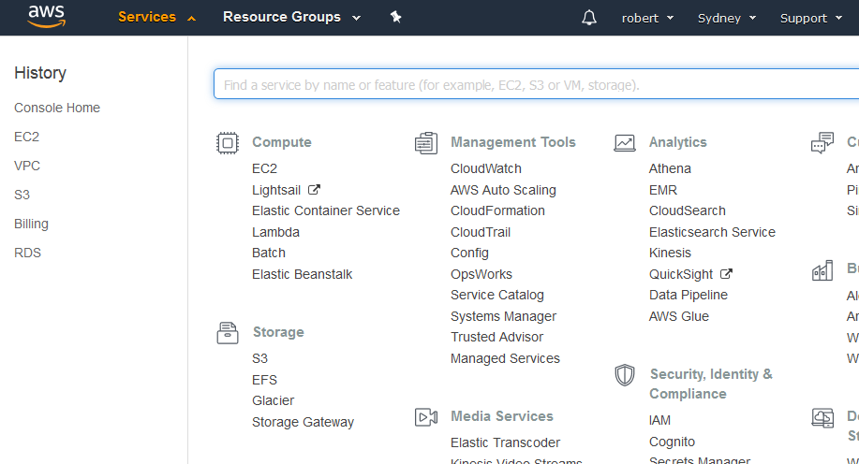
Virtual Machines - Creation

Slide 14
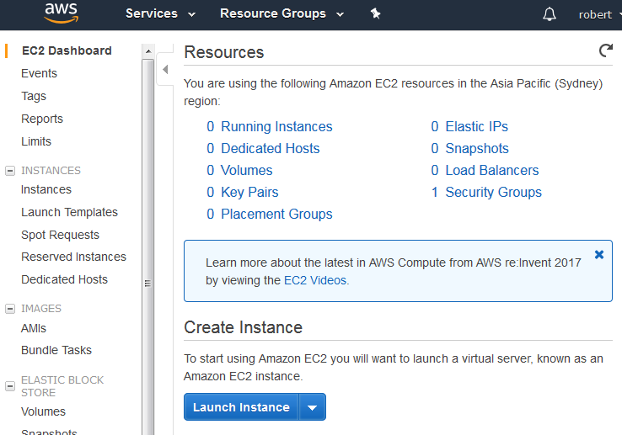
Virtual Machines - Creation

Slide 15
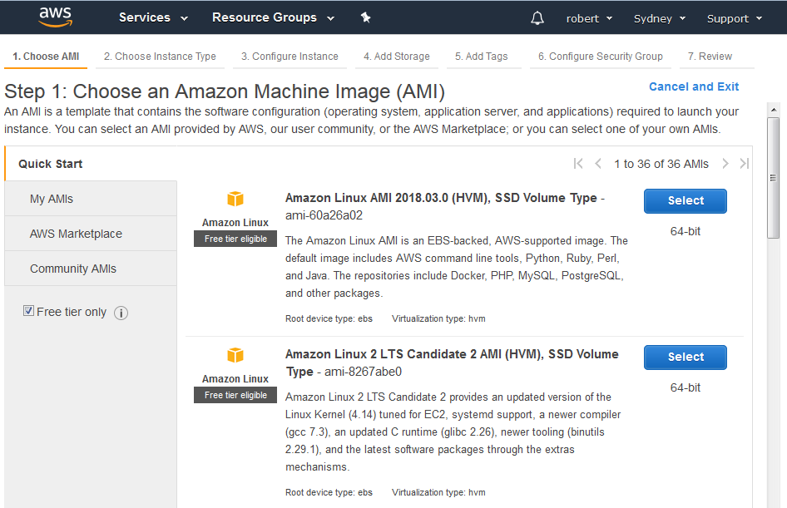
VM Creation – Choose AMI

Slide 16
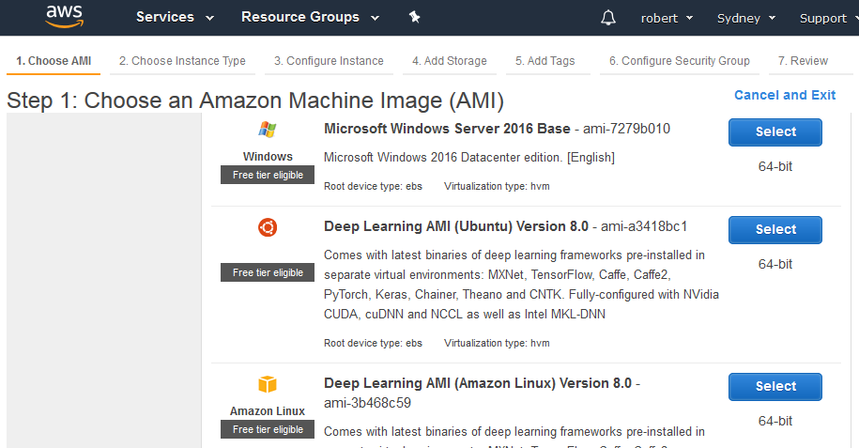
VM Creation – Choose AMI
Scrolling down to select Windows Server 2016.

Slide 17
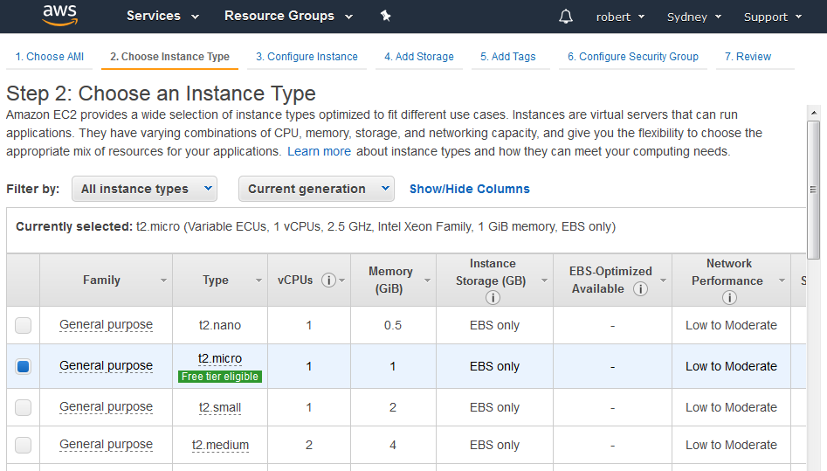
VM Creation - Choose Instance Type

Slide 18
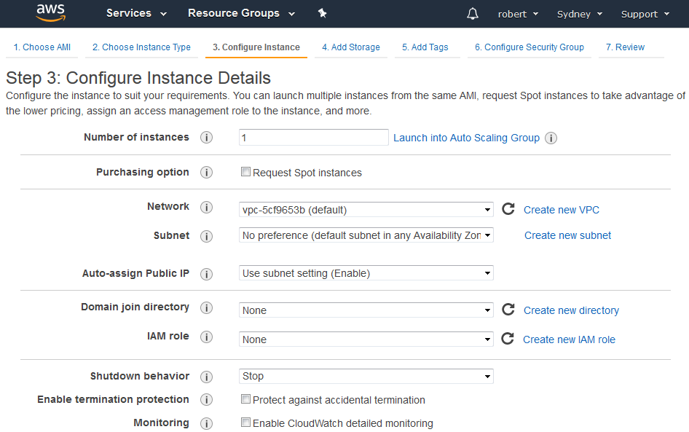
VM Creation – Configure Instance

Slide 19
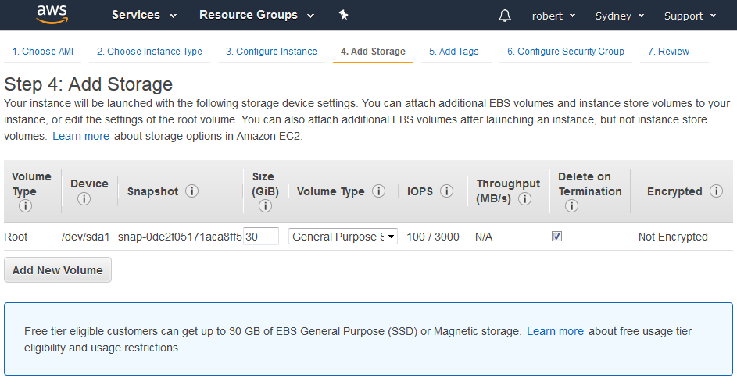
VM Creation – Add Storage
SSD

Slide 20
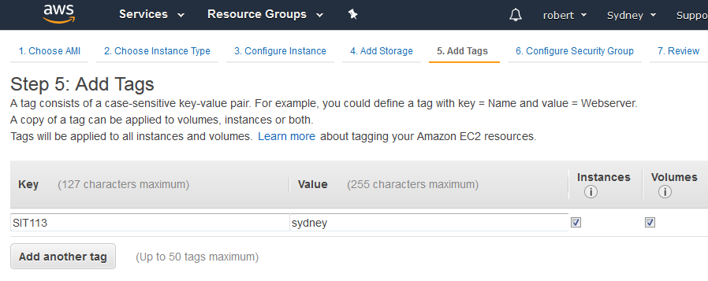
VM Creation – Add Tags
Tags will be applied to all instances and volumes in this launch.

Slide 21
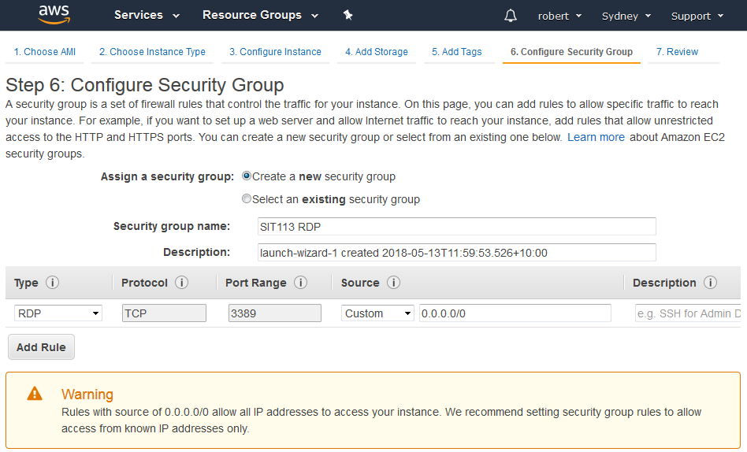
VM Creation – Security Group

Slide 22
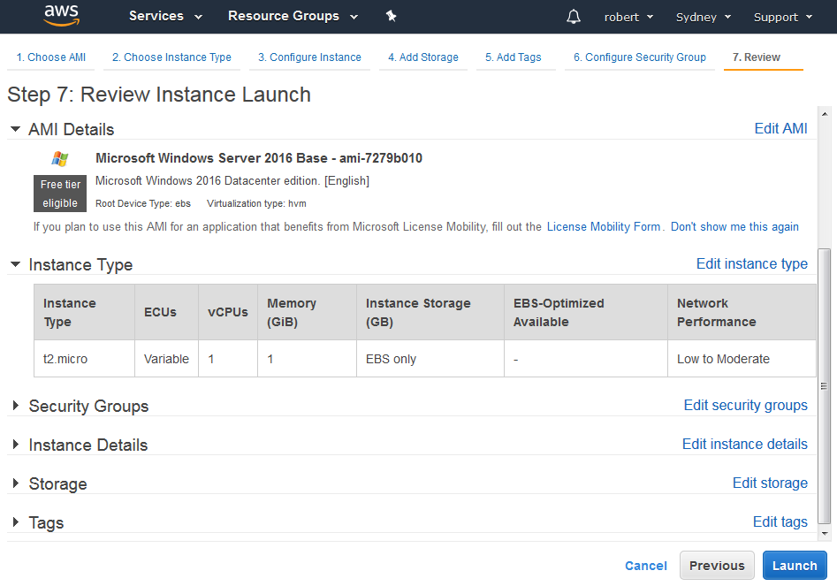
VM Creation – Review and Launch

Slide 23
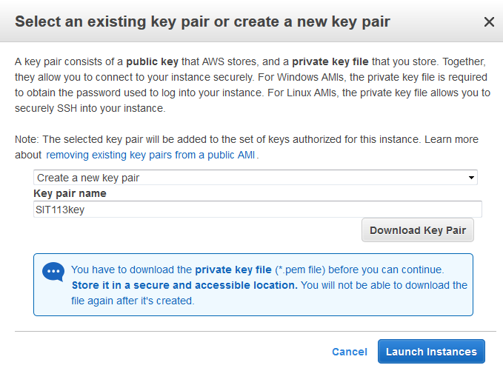
VM Creation – Review and Launch
A few minutes to complete this launch.

Slide 24
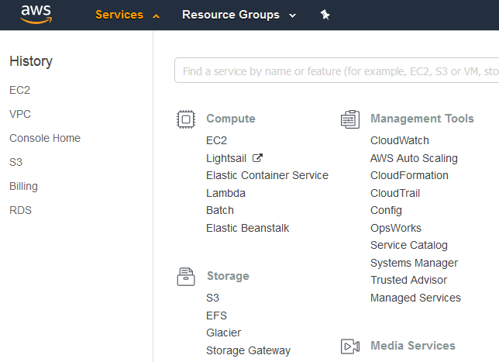
VM Creation – Check Launch

Slide 25
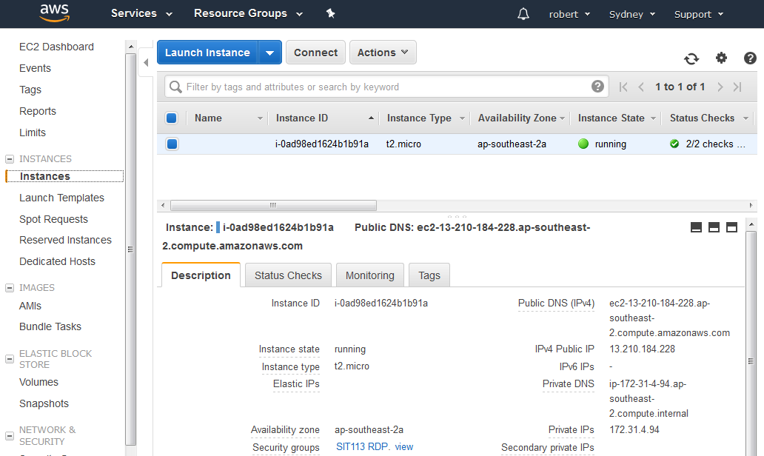
VM Creation – Check Launch

Slide 26
VM - Login

Slide 27
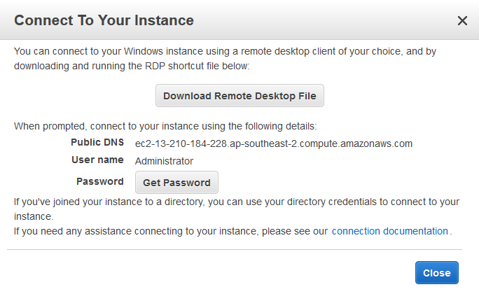
VM - Login

Slide 28
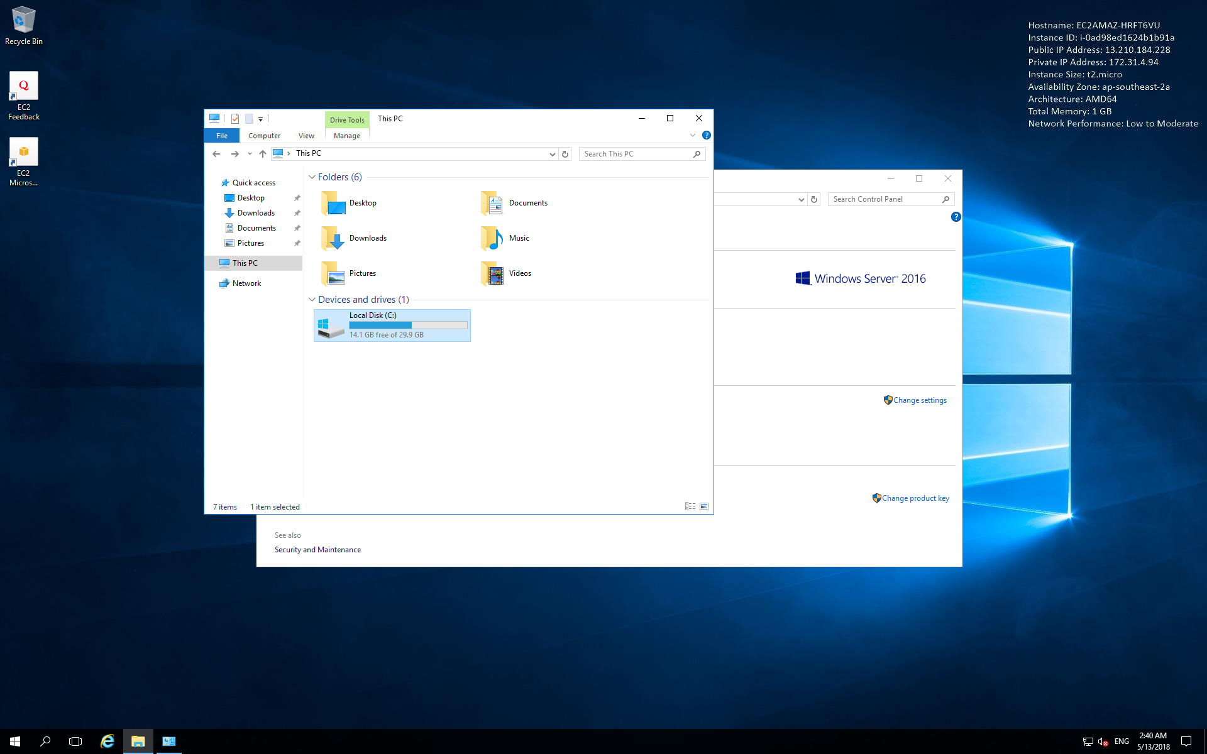
VM - Remote Desktop

Slide 29
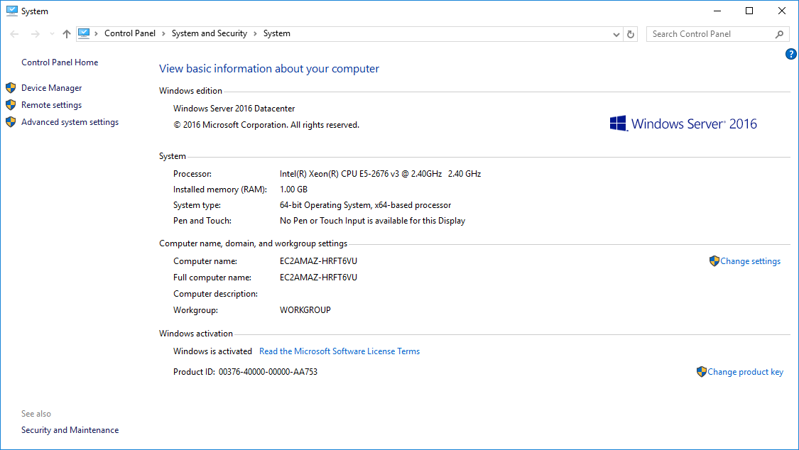
VM - System Properties

Slide 30
VM - Demonstration
This demonstration will show you:
how to create a VM on AWS
how to remove that VM

Slide 31
Summary
AWS https://aws.amazon.com/
Accounts
Free
Plans
Console
Sign In
Services
Resource Groups
Virtual Machines
Creation
Demonstration

